Slide 1
Advanced Java Programming
Web Application Development
Spring Boot

Slide 2
Contents
Spring Boot
Spring Boot Architecture
Components of SB
Creating Spring Boot Application

Slide 3
Spring Boot
Spring Boot is a project that is built on the top of the Spring Framework. It provides an easier and faster way to set up, configure, and run both simple and web-based applications.
It is a Spring module that provides the RAD (Rapid Application Development) feature to the Spring Framework.
It is used to create a stand-alone Spring-based application that you can just run because it needs minimal Spring configuration.

Slide 4
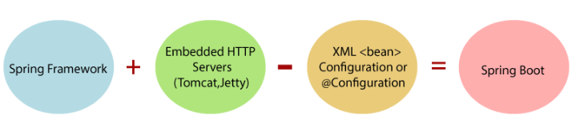
Spring Boot
In short, Spring Boot is the combination of Spring Framework and Embedded Servers.

Slide 5
Spring Boot
Key features and concepts of Spring Boot include:
Auto-Configuration: Spring Boot uses a convention-over-configuration approach, automatically configuring common components based on the dependencies in your project. This reduces the need for manual configuration.
Standalone: Spring Boot applications are self-contained and can be run as standalone Java applications, which means they don't require an external application server.
Spring Boot Starters: Starters are pre-configured templates for various application types (e.g., web, data, messaging). These starters include dependencies and configuration for specific use cases, making it easy to get started with various technologies.

Slide 6
Spring Boot
Embedded Servers: Spring Boot supports embedded web servers like Tomcat, Jetty, and Undertow, so you can package your application as a JAR or WAR and run it without deploying to an external server.
Spring Initializr: An online tool and command-line interface for generating Spring Boot projects with custom configurations and dependencies.

Slide 7
Spring Boot
Advantages:
It increases productivity and reduces development time.
It also minimizes writing multiple boilerplate codes (the code that has to be included in many places with little or no alteration), XML configuration, and annotations.
It provides opinionated 'starter' POMs to simplify our Maven configuration.

Slide 8
Spring Boot
Limitations:
Spring Boot can use dependencies that are not going to be used in the application. These dependencies increase the size of the application.

Slide 9
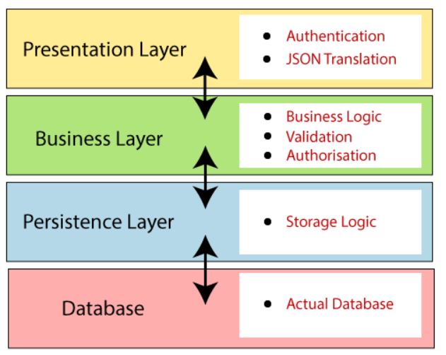
Spring Boot Layers
Spring Boot follows a layered architecture in which each layer communicates with the layer directly below or above (hierarchical structure) it.

Slide 10
Spring Boot Layers
Presentation Layer: The presentation layer handles the HTTP requests, translates the JSON parameter to object, and authenticates the request and transfer it to the business layer. In short, it consists of views i.e., frontend part.
Business Layer: The business layer handles all the business logic. It consists of service classes and uses services provided by data access layers. It also performs authorization and validation.

Slide 11
Spring Boot Layers
Persistence Layer: The persistence layer contains all the storage logic and translates business objects from and to database rows.
Database Layer: In the database layer, CRUD (create, retrieve, update, delete) operations are performed.

Slide 12
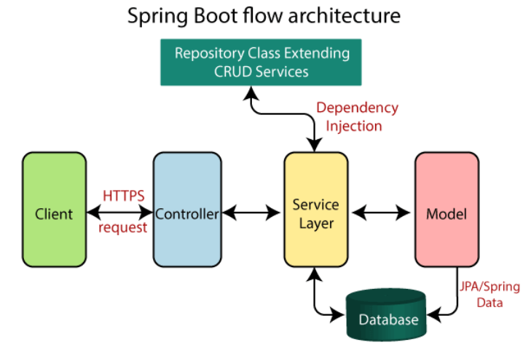
Spring Boot Architecture

Slide 13
Spring Boot Architecture
The client makes the HTTP requests (PUT or GET).
The request goes to the controller, and the controller maps that request and handles it.
After that, it calls the service logic if required.
In the service layer, all the business logic performs. It performs the logic on the data that is mapped to JPA with model classes.
A JSP page is returned to the user if no error occurred.

Slide 14
Spring Boot Architecture
Spring Data JPA is a part of the larger Spring Data project that provides a powerful and consistent programming model for data access.
It simplifies the development of data access layers by abstracting away much of the boilerplate code needed for common CRUD operations.
In Spring Data JPA, repository interfaces define methods for CRUD operations and querying data.

Slide 15
SB Application
Spring Boot Hello World Example - javatpoint

